Slide 1


Module E1
TOGAF 9.1
Changes Overview
V9.1 Edition Copyright © 2009-2011
All rights reserved
Published by The Open Group, 2011
Notes:
This module is an extra module intended to provide a high-level overview of the changes between TOGAF 9 and 9.1
This module is based on the White Paper W118

Slide 2

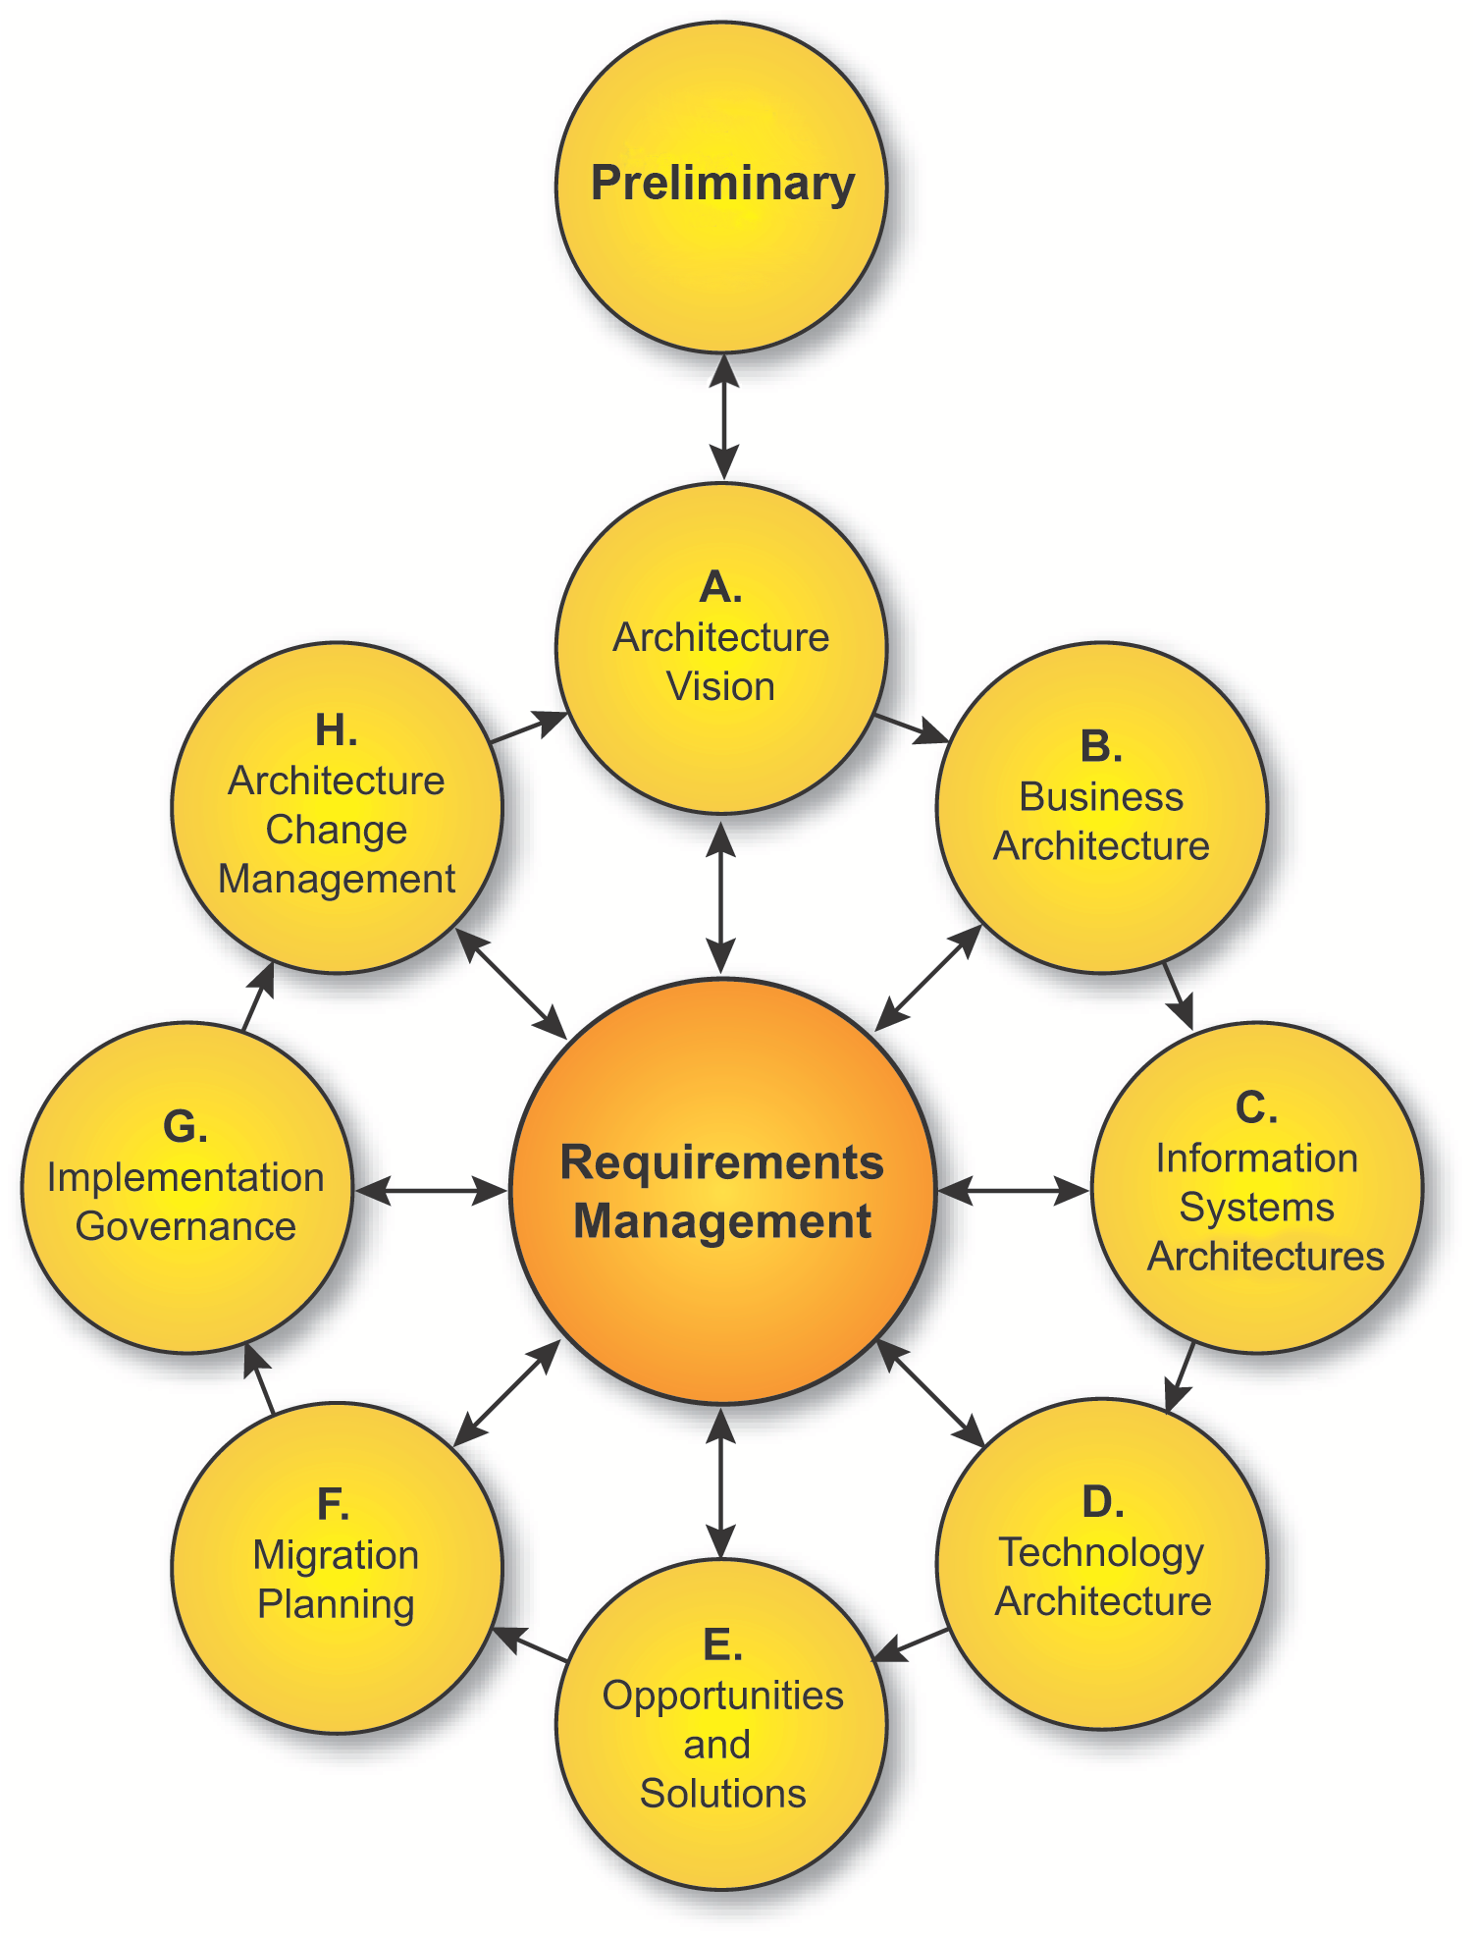
TOGAF 9.1 Changes Overview
TOGAF is a registered trademark of The Open Group in the United States and other countries

Slide 3
Audience
The audience for this module is
  Enterprise architects, business architects, data architects, systems architects, solutions architects and senior managers seeking an overview of what has changed between TOGAF 9 and TOGAF 9.1
  A prior knowledge of TOGAF 9 is presumed
c

Slide 4
Module Objectives
To understand
  The key changes between TOGAF 9 and TOGAF 9.1
  The implications on the TOGAF 9 Certification program
Notes:
These are the objectives of this module
(Syllabus Reference: Unit Bridge 1, Learning Outcome 3: You should be able to explain the high-level differences between TOGAF 8.1.1 and TOGAF 9.)

Slide 5


Agenda
TOGAF 9.1 Components and Structure
TOGAF 9.1 Change Highlights
TOGAF 9.1 Features Removed
TOGAF 9.1 Features Revised
TOGAF 9.1 and Certification
Backup Slides
  TOGAF 9.1 Detailed Changes

Slide 6
TOGAF 9.1
TOGAF 9.1 was released in December 2011
It is the first maintenance update to TOGAF 9
It is an upwards-compatible evolution from TOGAF 9, addressing usage feedback and comments raised
  It addresses over 400 comments received
  Contains over 450 changes
TOGAF 9 Technical Corrigendum 1 (Document U112) is available describing each change in detail
Notes:
TOGAF 9.1 includes a set of maintenance updates based on feedback received on the 2009 publication of TOGAF 9. As such, the changes are upwards-compatible adding clarification, consistency, and additional details where needed. A separate document describing the changes including rationale is available as TOGAF 9 Technical Corrigendum 1 (Document U112).[1]
[1] TOGAF 9 Technical Corrigendum 1 can be obtained from www.opengroup.org/bookstore/catalog/u112.htm.

Slide 7
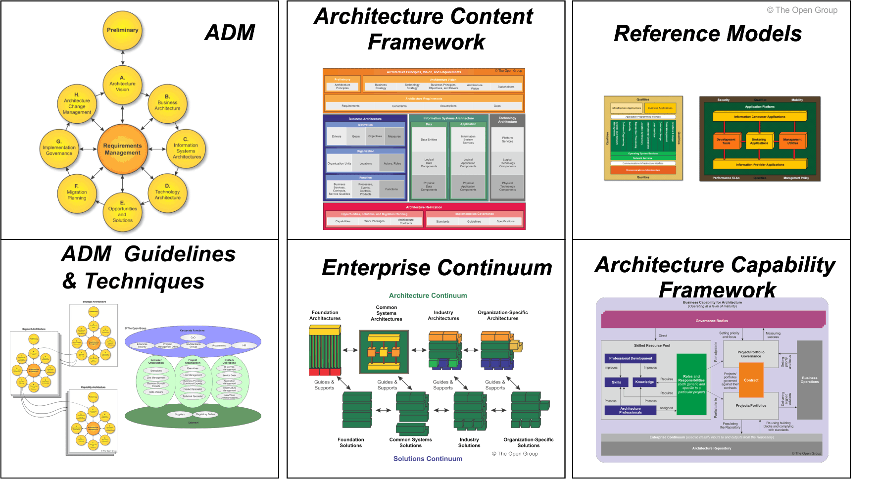
TOGAF 9.1 Components
Notes:
The main components remain the same as TOGAF 9

Slide 8

Part I - Introduction
Preface, Executive Overview, Core Concepts, Definitions and Release Notes
Part II – Architecture Development Method
Introduction to ADM
ADM Phase Narratives
Part III – ADM Guidelines and Techniques
Guidelines for Adapting the ADM Process
Techniques for Architecture Development
Part IV – Architecture Content Framework
Content Metamodel
Architectural Artifacts
Architecture Deliverables
Building Blocks
Part V – Enterprise Continuum and Tools
Enterprise Continuum
Architecture Partitioning
Architecture Repository
Tools for Architecture Development
Part VI – TOGAF Reference Models
Foundation Architecture: Technical Reference Model
Integrated Information Infrastructure Reference Model
Part VII – Architecture Capability Framework
Architecture Board
Architecture Compliance
Architecture Contracts
Architecture Governance
Architecture Maturity Models
Architecture Skills Framework
Notes:
This slide shows the TOGAF 9.1 Specification table of contents, which remains the same

Slide 9
TOGAF 9.1 Change Highlights
Editorial improvements. Definitions clarified. The Document Categorization Model removed
Part I - Introduction
Editorial improvements. Objectives sections reworked. Phases E and F descriptions reworked
Preface, Executive Overview, Core Concepts, Definitions and Release Notes
Part II – Architecture Development Method
Introduction to ADM
ADM Phase Narratives
Editorial improvements. SOA chapter revised to reflect latest work in The Open Group. Introductory text on Architectural styles added. The concepts of levels/iteration/partitions have been clarified and made consistent
Part III – ADM Guidelines and Techniques
Guidelines for Adapting the ADM Process
Techniques for Architecture Development
Part IV – Architecture Content Framework
Content Metamodel
Architectural Artifacts
Corrections have been made to the metamodel diagrams and to aspects of the metamodel. Reworked descriptions of Architectural Artifacts and Viewpoints. The Building Blocks Example has been removed
Architecture Deliverables
Building Blocks
Part V – Enterprise Continuum and Tools
Enterprise Continuum
Architecture Partitioning
Editorial improvements. The Tools Evaluation Criteria and Guidelines have been removed. The relationship of the Architecture Repository to the Enterprise Repository has been clarified
Architecture Repository
Tools for Architecture Development
Part VI – Reference Models
Foundation Architecture: Technical Reference Model
Integrated Information Infrastructure Reference Model
Part VII – Architecture Capability Framework
No changes
Architecture Board
Architecture Compliance
Architecture Contracts
Architecture Governance
Minor editorial Improvements
Architecture Maturity Models
Architecture Skills Framework

Slide 10
TOGAF 9.1: Material Removed
Part I - Introduction
The Document Categorization Model has been removed (Chapter 2)
Definitions of terms where usage is not distinctive from the common dictionary definition have been removed (Chapter 3)
The Building Blocks example has been removed (chapter 37)
The Evaluation Criteria and Guidelines have been removed (Chapter 42)
Preface, Executive Overview, Core Concepts, Definitions and Release Notes
Part II – Architecture Development Method
Introduction to ADM
ADM Phase Narratives
Part III – ADM Guidelines and Techniques
Guidelines for Adapting the ADM Process
Techniques for Architecture Development
Part IV – Architecture Content Framework
Content Metamodel
Architectural Artifacts
Architecture Deliverables
Building Blocks
Part V – Enterprise Continuum and Tools
Enterprise Continuum
Architecture Partitioning
Architecture Repository
Tools for Architecture Development
Part VI – Reference Models
Foundation Architecture: Technical Reference Model
Integrated Information Infrastructure Reference Model
Part VII – Architecture Capability Framework
Architecture Board
Architecture Compliance
Architecture Contracts
Architecture Governance
Architecture Maturity Models
Architecture Skills Framework
Notes:
This highlights where material has been removed

Slide 11
TOGAF 9.1: Material Revised
Part I - Introduction
The "Objectives" sections of the ADM phases have been reworked to focus on actual objectives rather than techniques or a list of steps (chaps 6-17)
Phase E and F descriptions have been reworked to match the level of detail in other phases (chaps 13,14)
The concepts of levels. Iterations and partitions have been clarified and made consistent. (chaps 19/20/40)
Additional introductory text on architectural styles has been added in Part III, Chapter 18
The SOA chapter (Part III, Chapter 22) has been updated to describe the latest work from The Open Group
Preface, Executive Overview, Core Concepts, Definitions and Release Notes
Part II – Architecture Development Method
Introduction to ADM
ADM Phase Narratives
Part III – ADM Guidelines and Techniques
Guidelines for Adapting the ADM Process
Techniques for Architecture Development
Part IV – Architecture Content Framework
Content Metamodel
Architectural Artifacts
Architecture Deliverables
Building Blocks
Part V – Enterprise Continuum and Tools
Enterprise Continuum
Architecture Partitioning
Architecture Repository
Tools for Architecture Development
Part VI – Reference Models
Foundation Architecture: Technical Reference Model
Integrated Information Infrastructure Reference Model
Part VII – Architecture Capability Framework
Architecture Board
Architecture Compliance
Architecture Contracts
Architecture Governance
Architecture Maturity Models
Architecture Skills Framework

Slide 12
TOGAF 9.1 and Certification
The TOGAF 9 Certification for People Program has been designed to accommodate maintenance updates to the TOGAF 9 standard such as TOGAF 9.1
The two levels of certification remain as TOGAF 9 Foundation and TOGAF 9 Certified
Individuals who are currently certified in the TOGAF 9 People Certification program remain certified
The Conformance Requirements for TOGAF 9 Certification have been updated and will become mandatory on June 1, 2012
All Accredited TOGAF 9 Training Courses will be updated to the revised Conformance Requirements by June 1, 2012

Slide 13
TOGAF 9.1 and Certification
In the period between December 1, 2011 and June 1, 2012 candidates can study either to the original Conformance Requirements or the revised Conformance Requirements
The examinations have been designed to accommodate both up to June 2013, which allows candidates up to twelve months after studying to take the exam
The reference text provided with the Open Book examinations will remain TOGAF 9 until June 1, 2012 and will then switch to TOGAF 9.1 after that date

Slide 14
TOGAF 9.1 and Certification
December 1 2011
June 1 2012
June 1 2013
Accredited TOGAF 9 Training Courses can cover either TOGAF 9 or 9.1 up to and including May 31 2012
Accredited TOGAF 9Training Courses must cover TOGAF 9.1 from June 1 2012
The Examinations accommodate both TOGAF 9 and TOGAF 9.1 until June 1 2013. The extended period allows for candidates who study and obtain a 12 month exam voucher
The exam questions can cover new TOGAF 9.1 material from June 1 2013
Open Book Reference Text TOGAF 9
Open Book Reference Text changes to TOGAF 9.1 on June 1 2012

Slide 15
TOGAF 9.1
Changes in Detail

Slide 16
TOGAF 9.1 Changes in Detail
The Document Categorization Model has been removed (Section 2.8).
Definitions of terms where usage by TOGAF is not distinctive from the common dictionary definition have been removed (Chapter 3).
The usage of the terms “application” versus “system” have been reviewed and made consistent (global change).
The “Objectives” sections of the phases have been reworked to focus on actual objectives rather than techniques or a list of steps (Chapters 6-17).
The possible artifacts (viewpoints) for each phase are now listed in the description of that phase, not just in Part IV, Chapter 35: Architectural Artifacts (Chapters 6-17).
Duplicate text in several places has been replaced with an appropriate reference:
  Gap Analysis in Phases B, C, and D now references Part III, Chapter 27: Gap Analysis (Chapters 8,10,11,12).
  Requirements Management in several phases now references Part II, Section 17.2.2: Requirements Development in the Requirements Management phase (Chapters 8,10,11,12).
The Phase E and F descriptions have been reworked to match the level of detail in other phases (Chapters 13,14).
The uses of terminology for Transition Architecture/Roadmap/Implementation Strategy have been clarified and made consistent (Chapters 13,14).

Slide 17
TOGAF 9.1 Changes in Detail
The concepts of levels/iterations/partitions have been clarified and made consistent. This includes a reorganization of material in Part III, Chapter 19: Applying Iteration to the ADM, Chapter 20: Applying the ADM across the Architecture Landscape, and Part V, Chapter 40: Architecture Partitioning (Chapters 5,19,20,40).
Additional introductory text on architectural styles has been added in Part III, Chapter 18: Introduction (Chapter 18).
Minor changes have been made to the Security Architecture chapter (Part III, Chapter 21: Security Architecture and the ADM) for consistency with the ADM (Chapter 21).
The SOA chapter (Part III, Chapter 22: Using TOGAF to Define & Govern SOAs) has been updated to describe the latest SOA Work Group output (Chapter 22).

Slide 18
TOGAF 9.1 Changes in Detail
The description of Architecture Principles now divides them into two types only – Enterprise and Architecture – whereas before they called out IT Principles separately. IT Principles are now seen as just part of Enterprise Principles (Chapter 23).
The Stakeholder Map included in the Stakeholder Management chapter (Part III, Chapter 24: Stakeholder Management) is now explicitly referred to as an example, the table has been highlighted to refer to Stakeholder Concerns, and the list of artifacts for each stakeholder updated (Chapter 24).
The Business Scenarios chapter (Part III, Chapter 26: Business Scenarios and Business Goals) has been renamed to Business Scenarios and Business Goals to better reflect the contents of the chapter (Chapter 26).
Corrections have been made to metamodel diagrams (Chapter 34).
Corrections have been applied to aspects of the metamodel (Chapter 34).
The terms “artifact” versus “viewpoint” have been clarified and made consistent. This includes a restructuring of Part IV, Chapter 35: Architectural Artifacts (Chapter 35).

Slide 19
TOGAF 9.1 Changes in Detail
Some of the artifacts have been renamed to better reflect their usage (Chapter 35):
  System/Data matrix becomes Application/Data matrix
  Class diagram has been replaced with Conceptual Data diagram and Logical Data diagram
  System/Organization matrix becomes Application/Organization matrix
  Role/System matrix becomes Role/Application matrix
  System/Function matrix becomes Application/Function matrix
  Process/System Realization diagram becomes Process/Application Realization diagram
  System Use-Case diagram becomes Application Use-Case diagram
  System/Technology matrix becomes Application/Technology matrix

Slide 20
TOGAF 9.1 Changes in Detail
The Building Blocks example has been removed (Chapter 37).
The relationship of the Enterprise Repository to the Architecture Repository is clarified in Part V, Chapter 41: Architecture Repository (Chapter 41).
The Evaluation Criteria and Guidelines have been removed from Part V, Chapter 42: Tools for Architecture Development (Chapter 42).
The chapter on Architecture Maturity Models (Part VII, Chapter 51: Architecture Maturity Models) has been editorially revised for consistency and clarity (Chapter 51).

Slide 21
Further Reading
TOGAF 9.1 Web Page
  http://www.opengroup.org/architecture/togaf91/
White paper: An Introduction to TOGAF 9.1
  http://www.opengroup.org/bookstore/catalog/w118.htm
TOGAF 9 Technical Corrigendum 1
  http://www.opengroup.org/bookstore/catalog/u112.htm
TOGAF Information Web site
  http://www.togaf.info

Slide 22
TOGAF 9.1 Changes Overview
TOGAF is a registered trademark of The Open Group in the United States and other countries

